Slide 1
Statistics Modul Quick Guide
ICT Precedent Development Group
2022.03.11

Slide 2
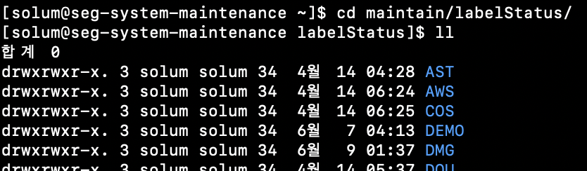
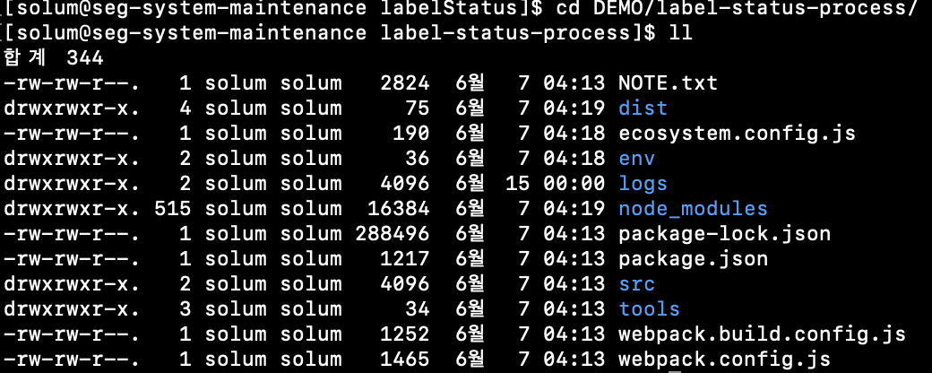
Register Statistics Module by using existing folder
Move path(/home/solum/maintain/labelStatus/) → Copy Source code → Remove exist build file and log.
→ Folder name is Customer Code

Slide 3
Label Statistics Module

Slide 4
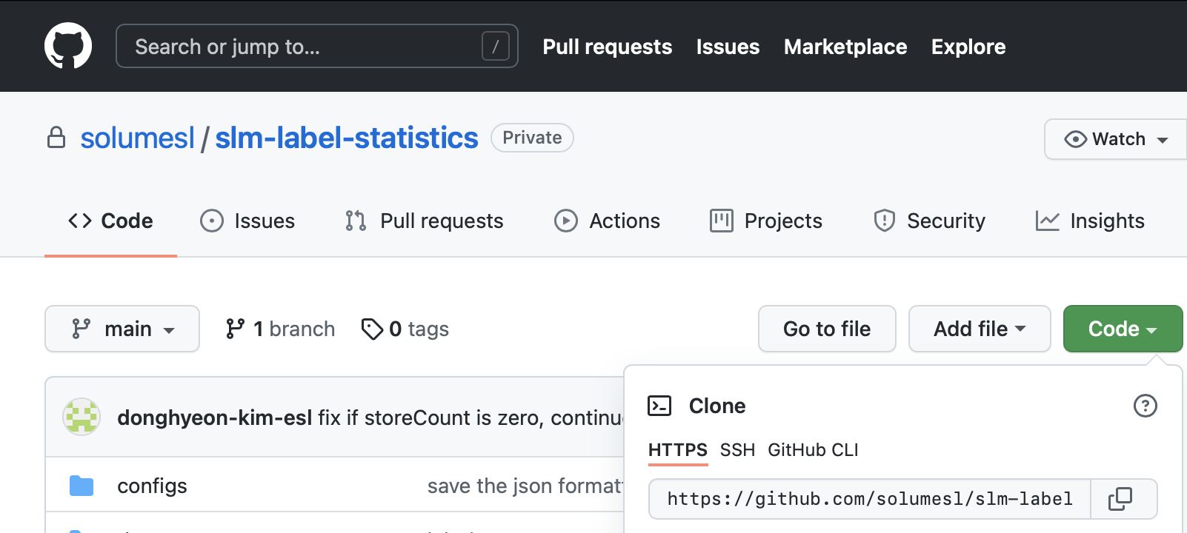
Register Statistics Module
Move path(/home/solum/maintain/labelStatus/)
Copy git clone link.(https://github.com/solumesl/slm-label-statistics.git)

Slide 5
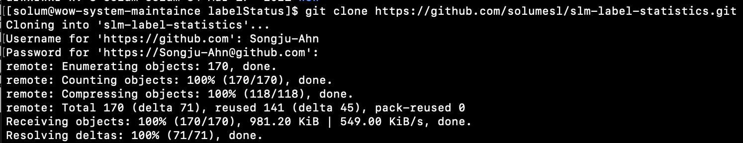
Register Statistics Module
Clone recently version module.
Clone recently version module.
→ Red box is Customer Code.

Slide 6
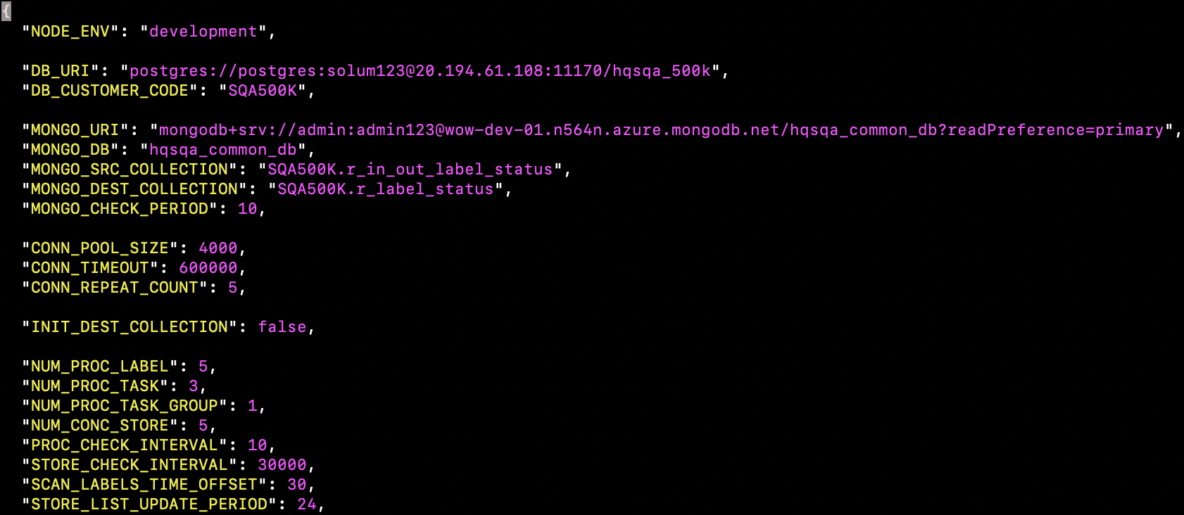
Register Statistics Module
Edit Config File
Red box is Customer Code.
Change DB connection info and STORE_LIST_UPDATE_PERIOD=0.166(10min)

Slide 7
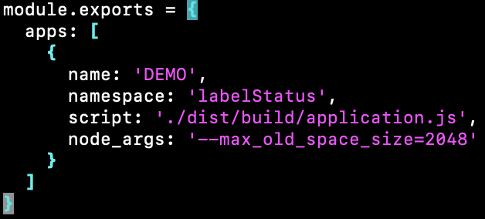
Edit Config File
Edit Config File
→ Red box is Customer Code.

Slide 8
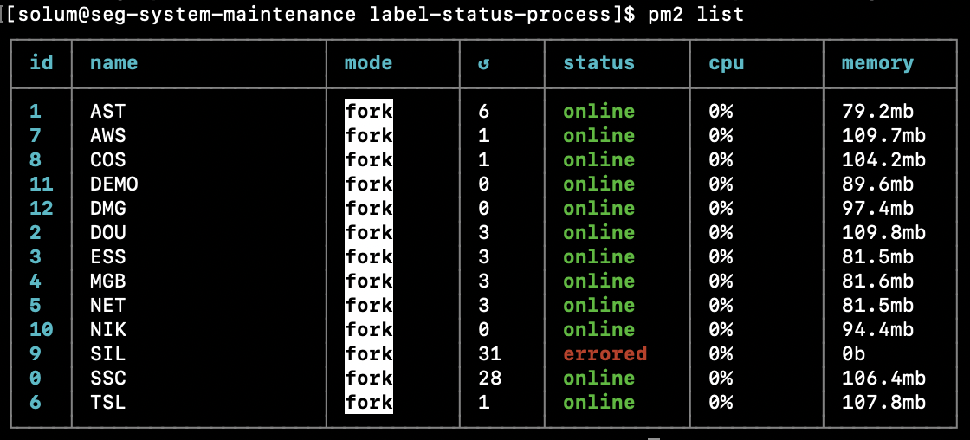
Register Statistics Module Process
Register pm2 process

Slide 9
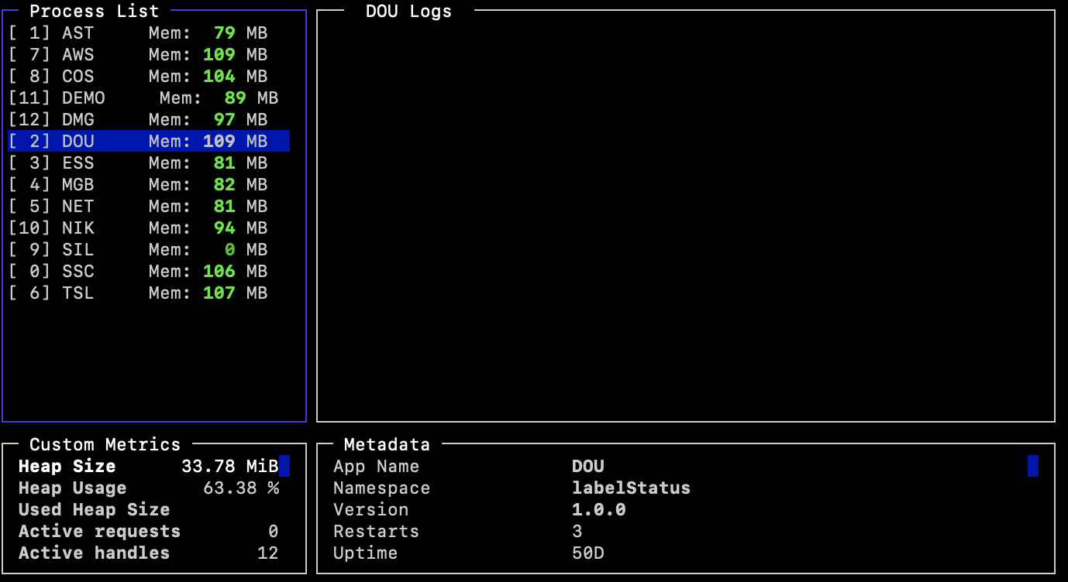
Check module status
When checking module status, using pm2 list command.
When monitoring all module, using pm2 monit command.

Slide 10
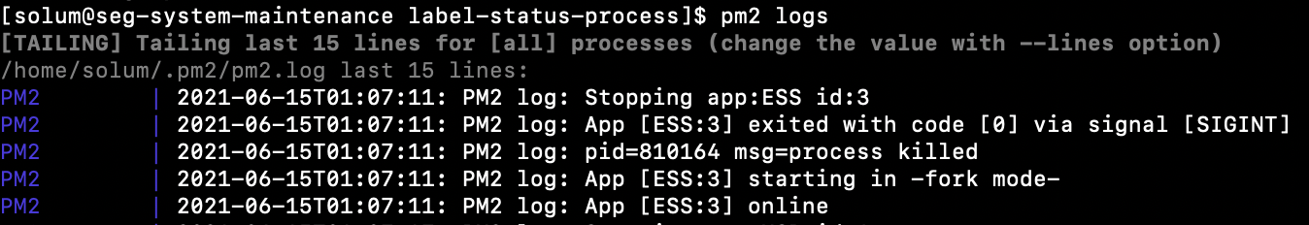
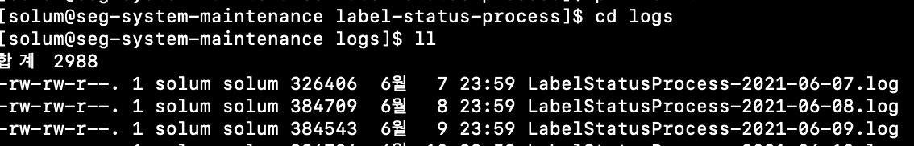
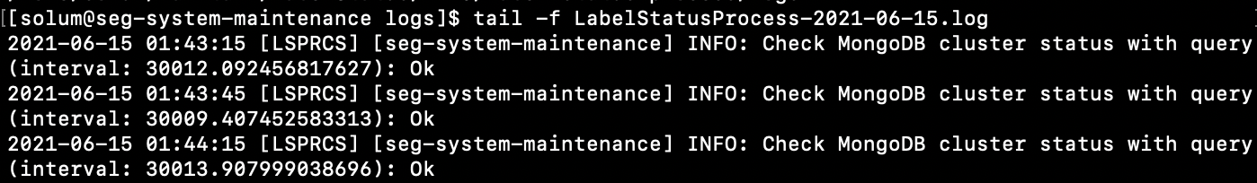
Check module Logs
When checking all module log, using pm2 logs command.
Log path is /home/solum/maintain/labelStatus/{CustomerCode}/label-status-process/logs
If check log file, using tail command

Slide 11
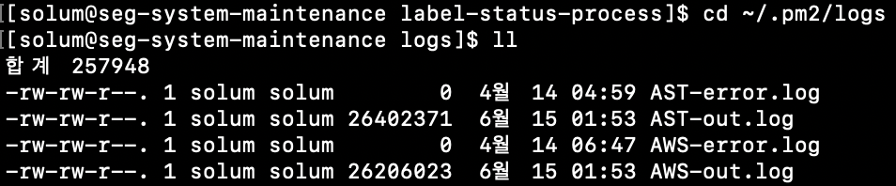
Check module Logs
Go to path ~/.pm2/logs and check log file when checking for module error/out log.

Slide 12
Reporting Module

Slide 13
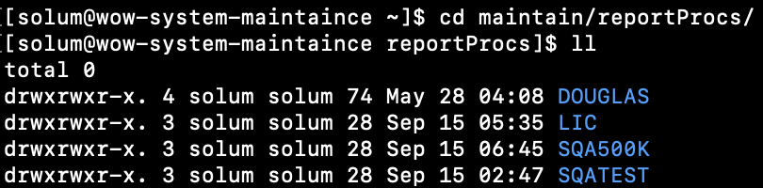
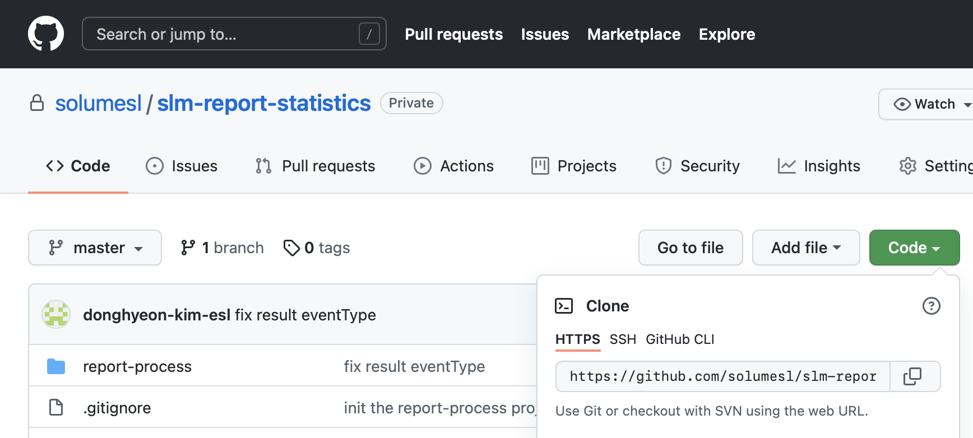
Register Report Module
Move path(/home/solum/maintain/ reportProcs/)
Copy git clone link.(https://github.com/solumesl/slm-report-statistics.git)

Slide 14
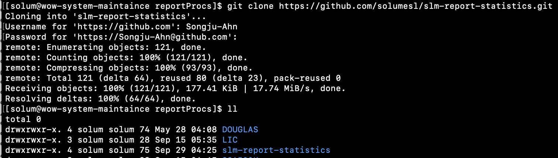
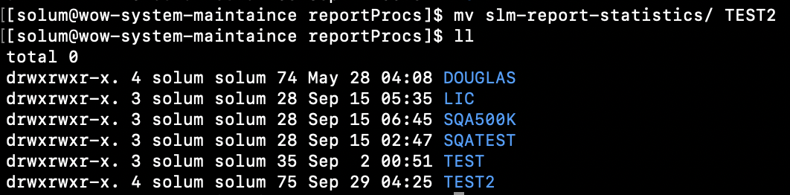
Register Report Module
Clone recently version module.

Slide 15
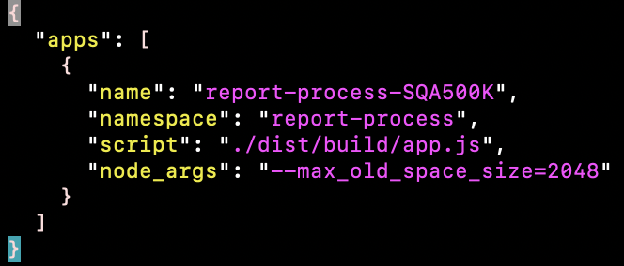
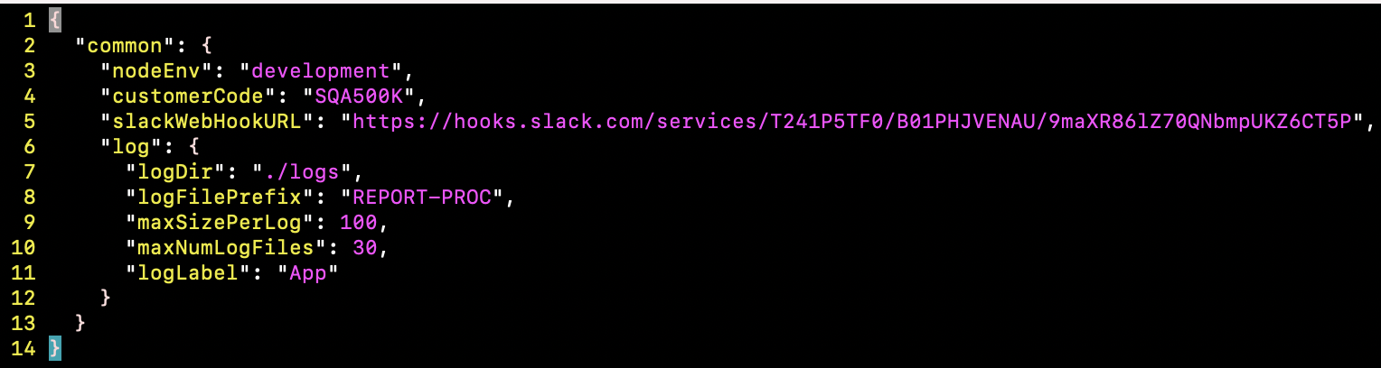
Edit Config File
Edit Config File
→ Red box is Customer Code.

Slide 16
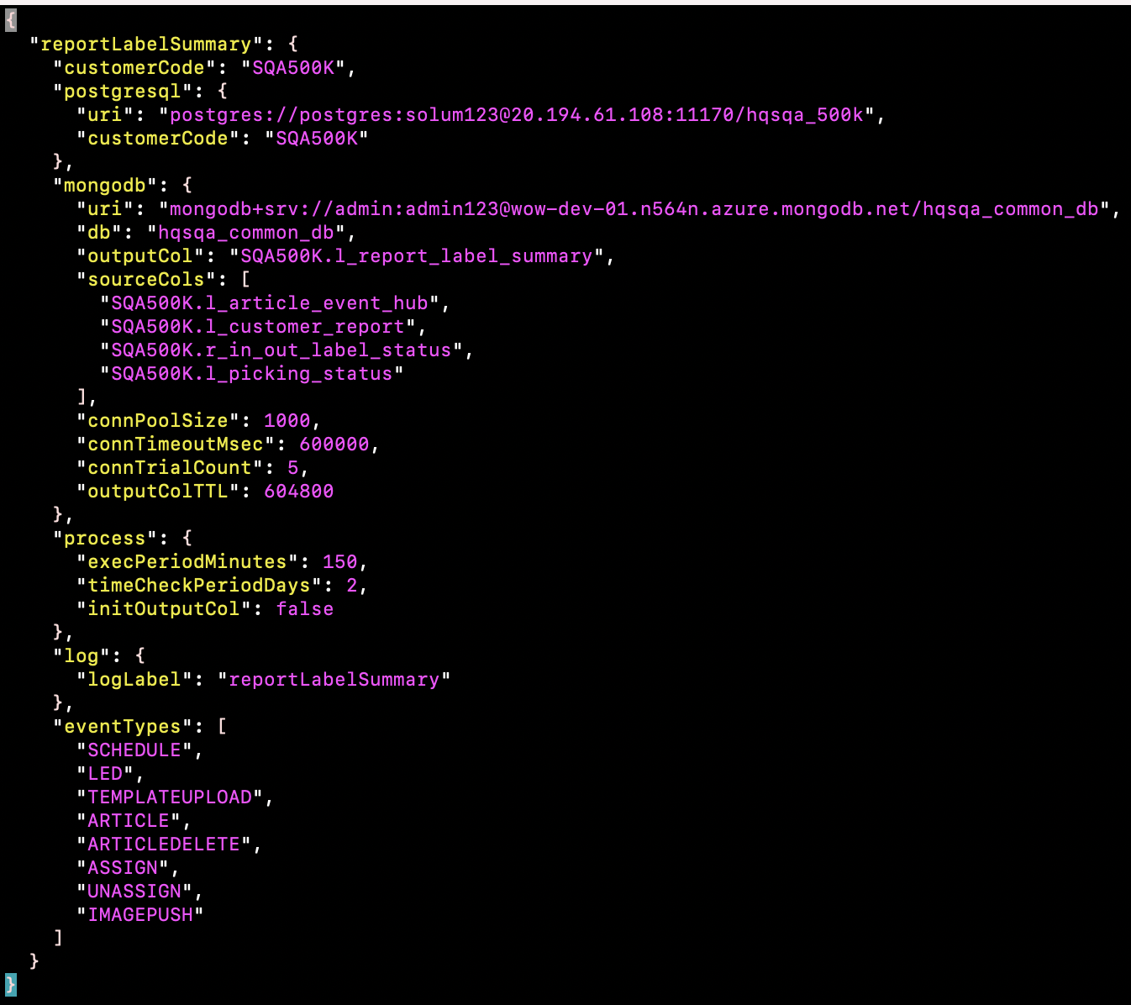
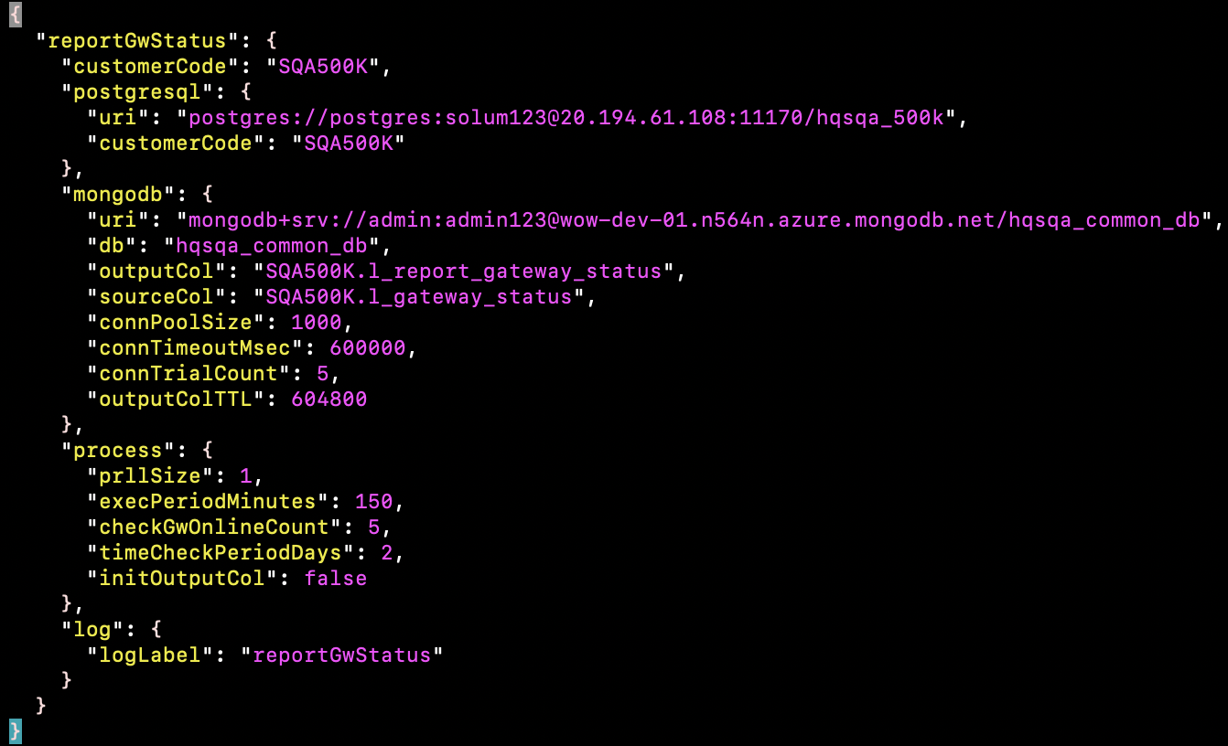
Edit Config File
→ Change DB connection info and Customer Code.

Slide 17
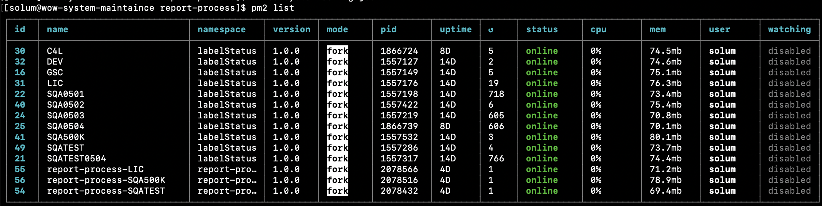
Register Statistics Module Process
Register pm2 process

Slide 18
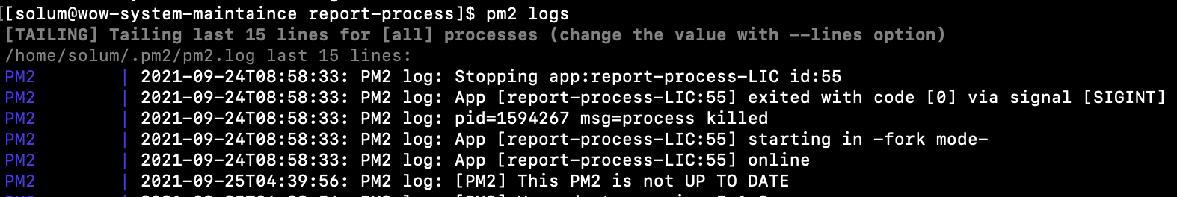
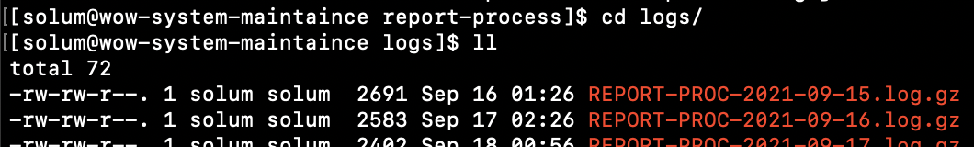
Check module Logs
When checking all module log, using pm2 logs command.
Log path is /home/solum/maintain/reportProcs/{CustomerCode}/report-process/logs
If check log file, using tail command

Slide 19
Monitoring VM information
Common (Common, Asia, STIDevelopment….)
Subscription : solumesl01
VM Name : asia-system-maintenance
IP : 20.196.193.132
login : solum/solum1!
EU
Subscription : solumesl03
VM Name : seg-system-maintenance
IP : 20.52.216.75
login : solum/solum1!
US
Subscription : solumesl05
VM Name : us-system-maintenance
IP : 52.255.175.89
login : solum/solum1!
Private Key file download link : https://sti4aims.slack.com/files/US953EAUW/F02D1KRHDS6/us-system-maintenance-ssh-key.pem

Slide 20

THANK YOU

